Slide 1



a00s3e3 - DONE
F= -1.77969
F = -1.77893
F= -1.77588, unstable

Slide 2










a00s5e3 - DONE
F = -2.986
F = -2.98574
F = -2.98733
F = -2.98580
F = -2.98637
F = -2.98644

Slide 3


a00s6e3 - DONE
F = -3.59170
F = -3.59404

Slide 4


a00s7e3 - DONE
F = -4.20090
F = -4.20224
Terran tried stripe (15.2, 20.2) & (12.2, 20.2). Unstable

Slide 5



a05s3e3 - DONE
F = -1.77283
F = -1.77232
F = -1.77005

Slide 6



a05s5e3 - DONE
F = -2.97229
F = -2.97422
F = -2.97365

Slide 7

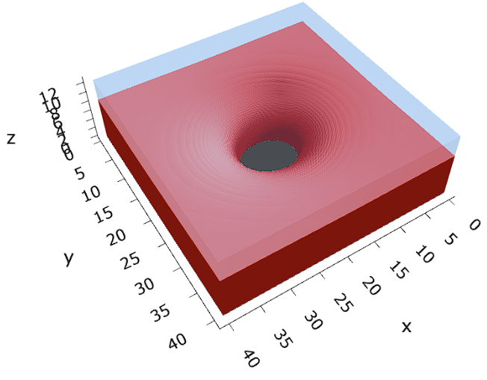

a05s6e3 - TERRAN
F = -3.57664
F = -3.57724
F = -3.57783

Slide 8



a05s7e3 - DONE
F = -4.18090
F = -4.18116
F = -4.18226

Slide 9


a10s2.5e3 - JOSH
a05s3e3
a10s5e3
a10s5e3

Slide 10

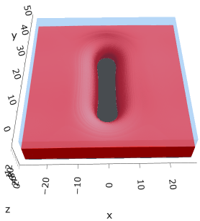

a10s5e3 - DONE
F = -2.93788
F = -2.93873
F = -2.93788

Slide 11
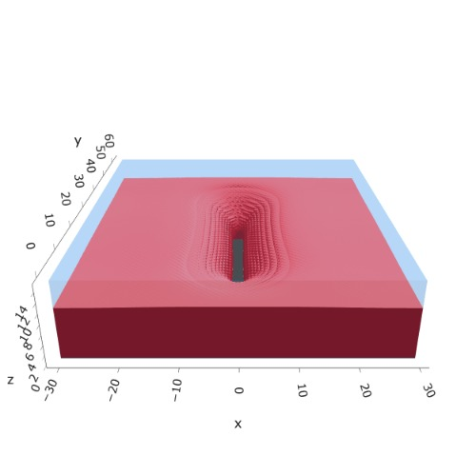
a10s0075 - JOSH
F = -4.42392
hom

Slide 12


a10s010 - DONE
F = -5.90899
F = -5.90938
Josh tried hole. Unstable

Slide 13


a15s5e3 - TERRAN
a20s5e3
a10s5e3
a20s15
a10s5e3

Slide 14
a15s1e2 - TERRAN
a20s5e3
a10s5e3
a20s15
a10s5e3

Slide 15
a20s5e3
F = -2.82020
No hol mic?

Slide 16
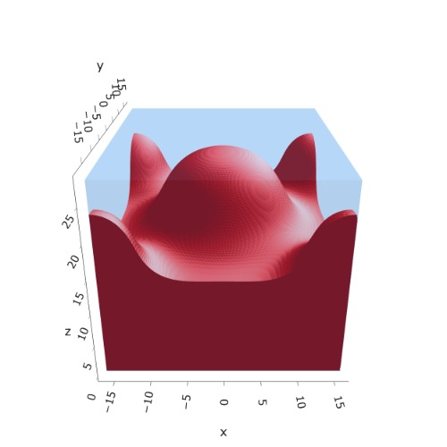

a20s015
F = -8.43956
F = -8.43935
F = -8.43930
n_coarse = 2
n_coarse = 2

Slide 17

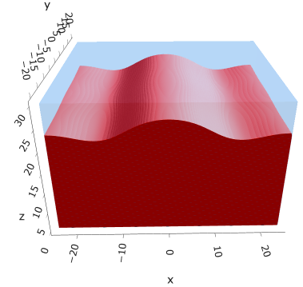

a20s020
F = -11.2306
F = -11.2317
F = -11.2321

Slide 18



a20s022
F = -12.3420
F = -12.3429
F = -12.3433

Slide 19




a20s025
F = -14.0028
F = -14.0029
F = -14.0033
F = -13.9755

Slide 20




a20s027 - DONE
F = -15.1049
F = -15.1047
F = -15.0898
F = -15.1050

Slide 21



a25s027 - DONE
F = -14.6022
F = -14.6018
F = -14.6015
Mul seems unstable (separation between layers low)
Str mul?

Slide 22




a25s030 - DONE
F = -16.1858
F = -16.1857
F = -16.1853
F = -16.1854

Slide 23
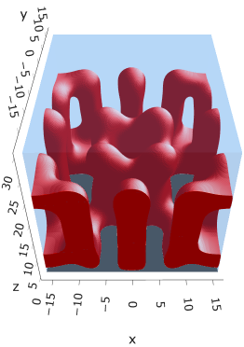
a30s005
F = -2.68749

Slide 24

a30s015

Slide 25
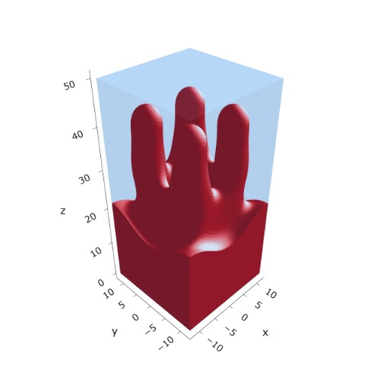
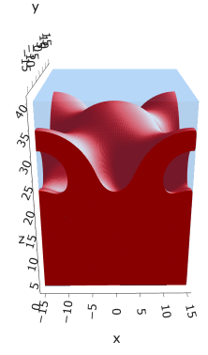


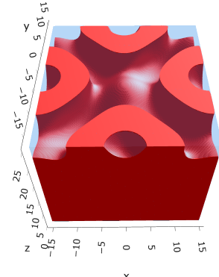
a30s020
F = -10.5057
F = -10.4971
F = -10.4878
F = -10.4764

Slide 26
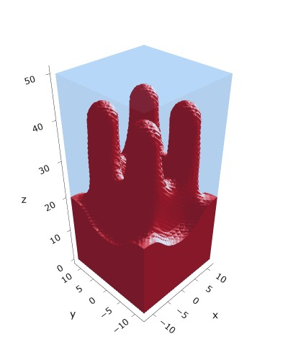
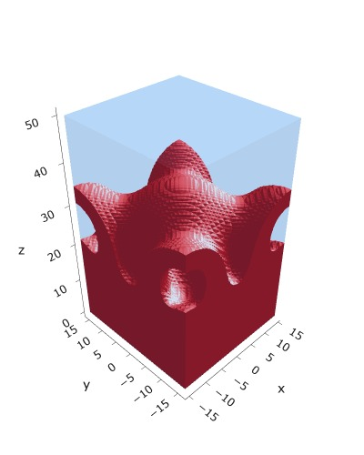


a30s020, chi = 1.30
F = -10.4392
F = -10.4272
F = -10.4245
F = -10.4090

Slide 27



a30s025 - DONE
F = -13.0548
F = -13.0538
F = -13.0394
Cyl?
Mul seems unstable

Slide 28




a30s030
F = -15.5953
F = -15.5886
F = -15.5897
F = -15.5739

Slide 29




a30s0325
F = -16.8486
F = -16.8312
F = -16.8491
F = -16.8268
2C isomin = 0.5

Slide 30





a30s035
F = -18.0779
F = -18.0943
F = -18.0946
F = -18.0887
F = -18.0782

Slide 31
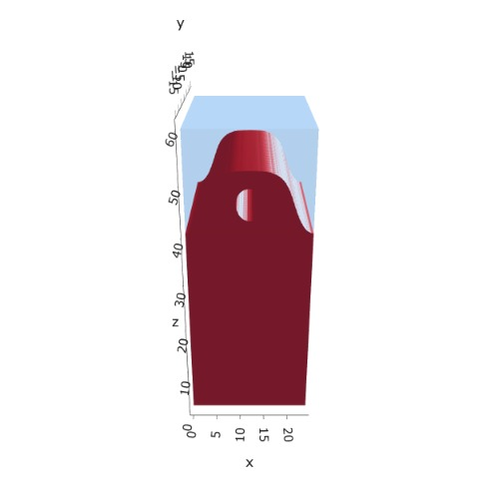

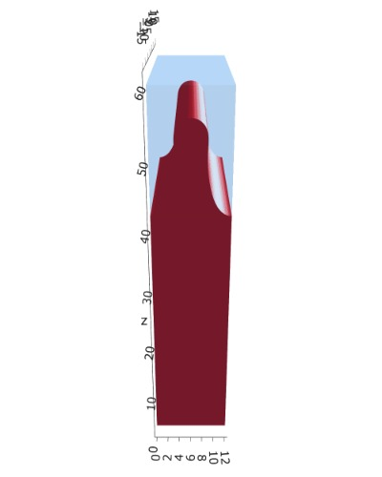
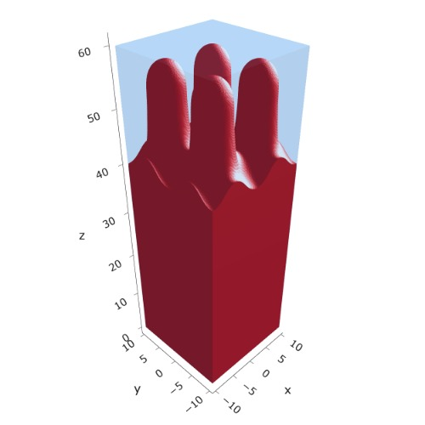



a30s040
n_coarse = 2
n_coarse = 3
dz =0.15
F = -20.5581
F = -20.5571
F = -20.5522
F = -20.5390
F = -20.5384

Slide 32
a30s040, chi = 1.35

Slide 33


a325s020
F = -10.2994
F = -10.2821

Slide 34




a35s020
Cyl?
3 “layers”
+1 dilute layer < isomin = 0.1

Slide 35





a35
s10
s12
s15
s18

Slide 36



Parallelization
$$α=0, χ=1.25, N=50, σ=0.02$$
$$α=0, χ=1.25, N=200, σ=0.005$$
$$L_{x}=L_{y}=23, { L}_{z}=15$$
Nth = 12: 500 it, 4.3 hrs
Nth = 8 : 500 it, 6.9 hrs
Nth = 6 : 415 it, 20 hrs (poss. mem bottleneck)

Slide 37







Exercise: Micelle / Stripe
s = 5e-03, N = 50, a = 0.0, x = 1.0
s = 5e-03, N = 75, a = 0.0, x = 1.0
Isosurface at pha = 0.1

Slide 38






a040x170s020

Slide 39






a040x170s010

Slide 40

a040x170s025

Slide 41














a040x170s022

Slide 42










a040x170 seed
See if becomes hex
cyl4-975
cyl4-12
cyl16-975
cyl16-1025
cyl1

Slide 43






a040x170s017

Slide 44












































a040x170s015 seed
Almost done
Almost done

Slide 45

















a040x170s013

Slide 46
















a040x170s010 seed

Slide 47














X200 x170 x130 x120 x100
F = −10.24458
F = − 9.14301
F = −11.0057
F = −10.2429
F = −11.0015
F = −9.63949
F = −10.2461
F = −10.9948
F = − 9.63030
F = −10.2431
F = −10.9953

Slide 48





a040x100 relaxation

Slide 49








































a040x100 seed
old
old

Slide 50


a040x120 relaxation
F = −10.24458

Slide 51





































a040x120 seed
cyl16-850
cyl16-825

Slide 52






a040x130 relaxation

Slide 53




a040x170 relaxation
F = −9.10347
1 neck

Slide 54







a040x200 relaxation

Slide 55










a040x200 seed
Note: not completely converged but stopped for resources

Slide 57


a0.40 x1.70

Slide 58





Zhulina JCP 1998
a = 0.01
0.1 mM
1 mM
May need to init using sine
10 mM
25 mM
Zhulina NVT; current GCE runs at Lz = 20

Slide 59

Carrillo Langmuir 2009

Slide 60

Parallelization

Slide 61
Equations
Quenched average, np, A --> \inf ; np/A → \sigma
Discrete Gaussian chain

Slide 62




Scaling (Alexander—de Gennes brush)
V = 4.2; H = 27.5 – 30.5
V = 2; H = 39 – 45.5

Slide 63






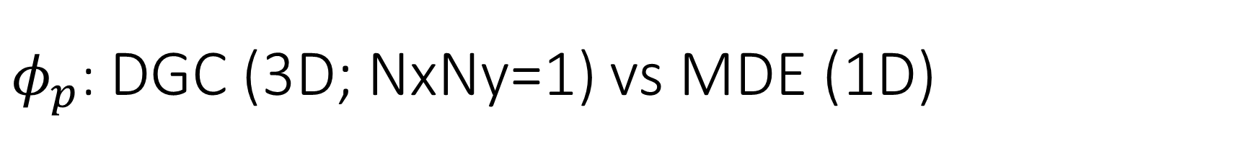
$φ_{p}$: DGC (3D; NxNy=1) vs MDE (1D)
Ns/sigs: dz = 0.10, Ngz_2 = 4$σ$; Chis/bs: dz = 0.25, Ngz_2 = 3.5$σ$

Slide 64


Numericals
Ys
Possibly do Ngz for multiple dzs

Slide 65








3D
Lxy = 1
Lxy = 10
Lxy = 5
Lxy = 15
y-z heatmaps for $φ_{p}$ at constant x

Slide 66





z-FFT vs z-FD (MDE) – REDFT01 xy(z)
Lx = 5, Ly = 5, Lz = 50. s = 0.02. x = 0.75. a = 0.00, N = 50
3D vs 1D (dashed): dz = 0.5, ds = 0.20; dz_1D = 0.113, ds_1D = 0.083
FFT (xyz)
FFT (yz vs pha)
FD (xyz)
FD (yz vs pha)
Diff btw 1D/3D should just be dz, ds, etc.

Slide 67
Specifying Grafted Points

Slide 68
Strategy
2D binary array for surface sites of homogeneously grafted polymer given grafting density, simulation box size, and discretization (and assuming dx = dy)
Fullspace must be periodic on x0 = xL, y0 = yL
Halfspace must be even on xL/2 and yL/2 (overlap of boundary following REDFT00) and periodic on x0 = xL, y0 = yL.
Homogeneous spacing as determined by regular hexagon, where grafting point at centroid of hexagon
In case there are edge effects, try shifting the centroids away from the boundaries of the xy-plane (only did for fullspace)
Make sure no edge effects by comparing results of full FFT with cos FFT

Slide 69
Test conditions
Sigma = 0.05 c/nm2
Lx = 15 nm
Ly = 15 nm
dx = 0.4 nm
Cast in terms of dx (for rounding and PBC for grafting points):
Sigma = 0.0668 c/nm2
Lx = 14.80 nm
Ly = 11.20 nm
(Sigma error decrease with dx)

Slide 70

Padded PBC (Full FFT)
Hexagons drawn for illustration of hexagon approach

Slide 71

Unpadded PBC (Full/Cos FFT)

Slide 72






Other conditions (full and half results overlapped to show match)
s = 0.0241 (20.28%; dx=0.4), Lx, Ly = 12.40, 20.80
s = 0.0208 (4.08%; dx=0.1), Lx, Ly = 12.90, 22.30
s = 0.1332 (11%; dx=0.1), Lx, Ly = 20.50, 20.40

